Slide 1
Sales Performance Dashboard – Superstore Data
Tracking Key Sales KPIs Across Regions and Time Periods
Objective:
This dashboard helps regional managers monitor sales, profit, and order trends for better decision-making.
Name - Santosh kr. Majhi
Date – 07/07/2025

Slide 2
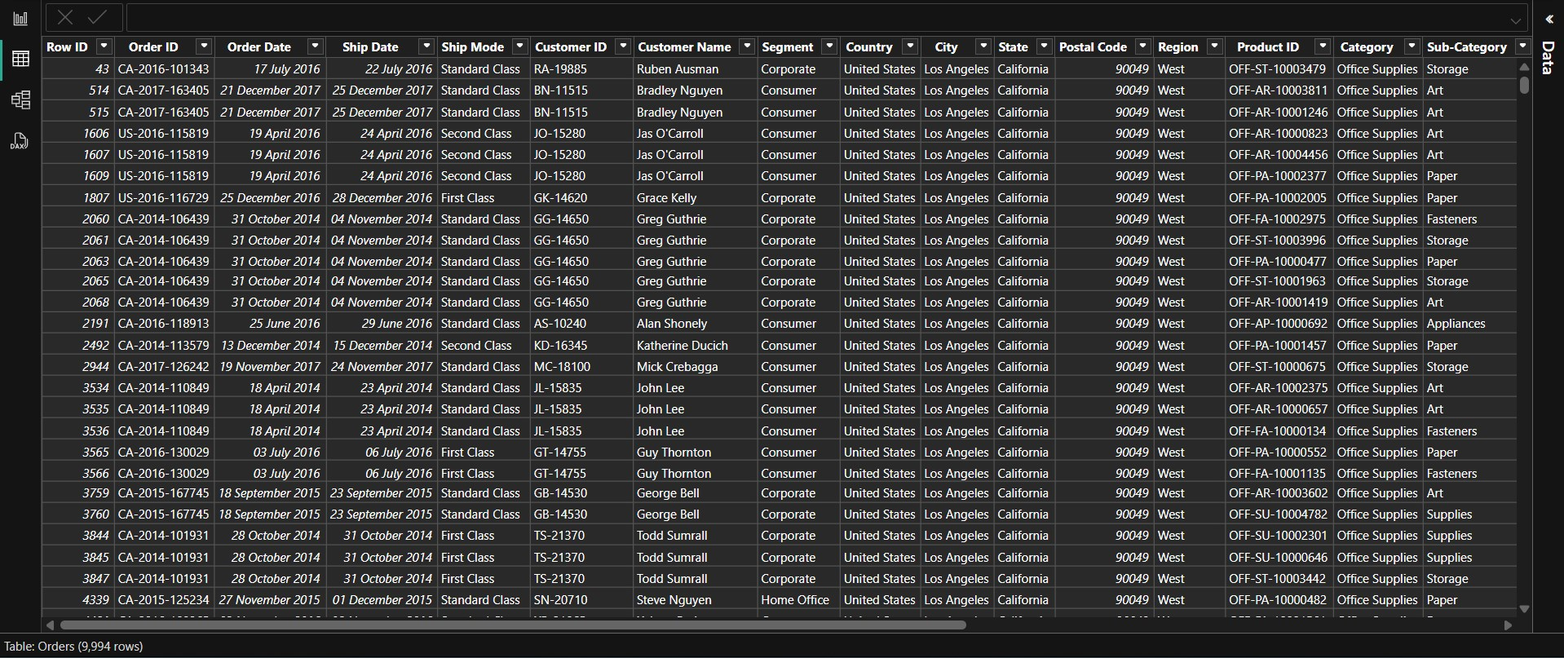
Dataset Summary
Source: Superstore Dataset (Kaggle/Tableau)
Size: 10,000 records from 2014–2017.
Key Fields :
Order Date, Region, Sales, Profit.
Category, Sub-Category, Customer Segment.
Cleaning : Checked data types, removed nulls, created DAX measures.

Slide 3
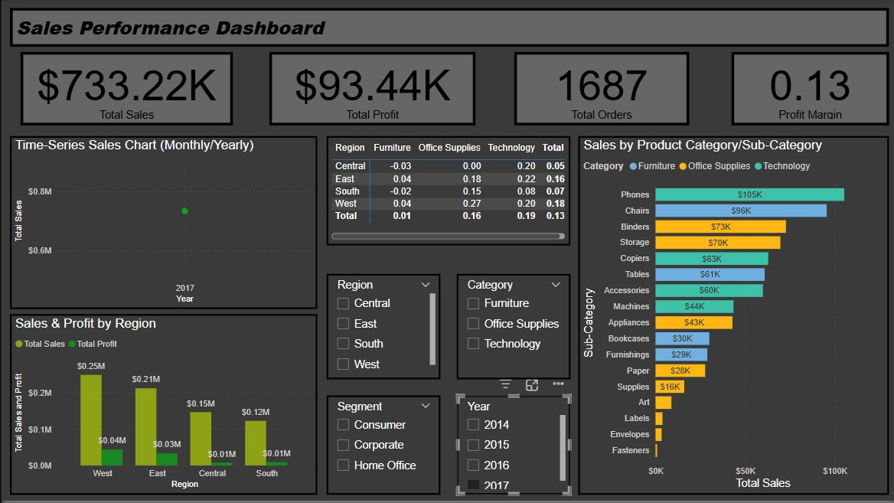
Top KPIs
Total Sales over the period: $2.3M, with a 12% YoY growth in 2017.
Contents:
Total Sales
Total Orders
Total Profits
Profit Margin

Slide 4
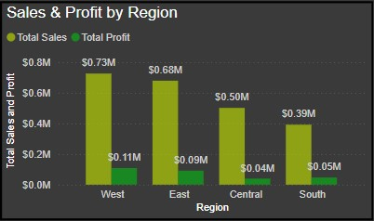
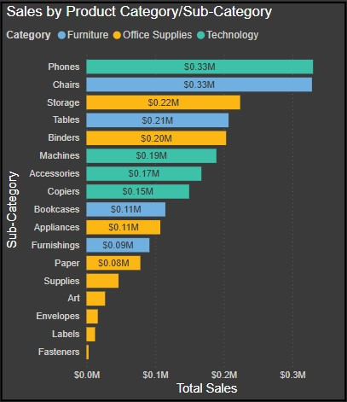
Performance by Region and Category
Bar chart: Sales by Region
Sales/Profit by Category/Sub-category
West region had the highest sales but also high returns.
Technology category leads in profit margins.
Office supplies underperforming in south.

Slide 5
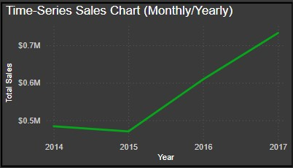
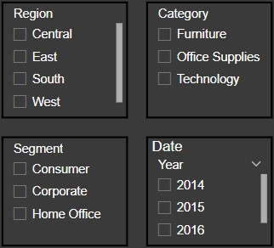
Monthly/Yearly Trends
Sales peak every Q4, likely due to holiday shopping trends.
2016 saw dip in Furniture category sales.
Filter used : Region, Category, Date Segment.

Slide 6
Insights & Actionable Suggestions
Insights
Recommendations
East has low sales.
Tech is most profitable.
Profit Margin falling in Q1.
Focus marketing in East.
Increase inventory for Tech.
Review shipping discounts/promos.

